Slide 1
FREELANCING APLLICATION MERN
TEAM NUMBER: NM2024TMID10155
TEAM MEMBERS:
ARCHANA A (211521104011)
DEEPIKA M (211521104032)
S R GNANESHWARI (211521104046)
RITHIKA S (211521104126)
ODURU LASYA (211521104100)

Slide 2
TABLE OF CONTENTS
ABSTRACT
INTRODUCTION
PROPOSED SYSTEM
IMPLEMENTATION:MERN STACK
FRONTEND
BACKEND
INTEGRATION
BLOCK DIAGRAM
MODEL SCREENSHOT
CONCLUSION

Slide 3
ABSTRACT
The Freelancing Platform is a full-stack MERN (MongoDB, Express.js, React, Node.js) web application designed to provide a centralized platform for freelancers and clients to connect, collaborate, and complete projects. The system streamlines the hiring process by allowing clients to post job opportunities, review freelancer profiles, and track project progress in real-time. Freelancers can bid on jobs, communicate with clients, and receive notifications about job updates. Enhanced by features such as secure user authentication, intelligent job matching, and robust data protection, this platform offers an efficient and scalable solution for managing freelance work, ensuring smooth transactions, and enhancing user satisfaction.

Slide 4
INTRODUCTION
Freelancing platforms are critical for individuals and businesses seeking to connect with skilled professionals while maintaining efficiency and transparency in project management. Traditionally, managing freelance work and client relationships has involved fragmented communication, manual processes, and a lack of centralized control, leading to delays and inefficiencies. To address these challenges, the Freelancing Application leverages modern web technologies to provide an easy-to-use, accessible platform for managing freelance projects. Built using the MERN stack, the system offers end-to-end management of the freelancing process, from job postings and bidding to real-time project tracking and final delivery, thereby optimizing the entire workflow for both freelancers and clients.

Slide 5
PROPOSED SYSTEM
The proposed system is a web-based freelancing platform that enables users to:
Register and log in to their accounts as either freelancers or clients.
Post job listings with detailed requirements, such as project descriptions, deadlines, and budgets.
Bid on available projects where freelancers can submit their proposals and pricing.
Track project progress in real-time, allowing clients and freelancers to monitor milestones and deliverables.
Communicate directly via an integrated messaging system to discuss project details, provide feedback, and make necessary revisions.
Receive notifications about project updates, job matches, or deadlines via email or SMS.
Experience enhanced security with features like data encryption, user authentication, and compliance with data protection laws.
The system also empowers administrators to oversee the management of job postings,
freelancer performance, and ensure proper resource allocation. Intelligent algorithms match
freelancers with relevant job opportunities based on their skills, while the admin can monitor
platform activity and maintain system efficiency.

Slide 6
IMPLEMENTATION:MERN STACK
FRONTEND
Material UI/Bootstrap: Used for styling to ensure a smooth, user-friendly experience across different devices, enabling freelancers and clients to easily navigate the platform.
Axios: Employed to handle HTTP requests between the frontend and backend, facilitating seamless communication for job postings, proposals, and project updates.
Real-Time Updates: Socket.io is integrated for real-time communication between clients and freelancers, enabling instant notifications for new messages, job bids, and project status updates.

Slide 7
BACKEND
Server-Side Logic: Handled by Express.js, managing routes and APIs for job postings, user authentication, project management, and payment processing.
MongoDB: A NoSQL database used for storing user profiles, job listings, proposals, project details, and transaction history. MongoDB Atlas is leveraged for cloud storage and easy scalability to handle high traffic and large datasets.
APIs: RESTful APIs are developed to manage data flow between the frontend and backend, supporting CRUD operations (Create, Read, Update, Delete) for job postings, freelancer bids, and user interactions.

Slide 8
INTEGRATION
Frontend-Backend Communication: Axios is used on the frontend to send API requests to the backend, which is handled by Express.js. This enables seamless data exchange for functionalities like job postings, submitting proposals, tracking project progress, and messaging between freelancers and clients.
Database Integration (MongoDB): The backend interacts with MongoDB to store and retrieve data related to users, job listings, bids, and project details. Express.js communicates with the database via Mongoose, a Node.js library that efficiently handles MongoDB queries and ensures smooth data transactions.
Real-Time Features: Socket.io enables real-time interaction between freelancers and clients, allowing instant chat, live project updates, and notifications for job status changes or bids. Additional features like WebRTC could be integrated for real-time voice/video communication between clients and freelancers, enhancing collaboration.

Slide 9
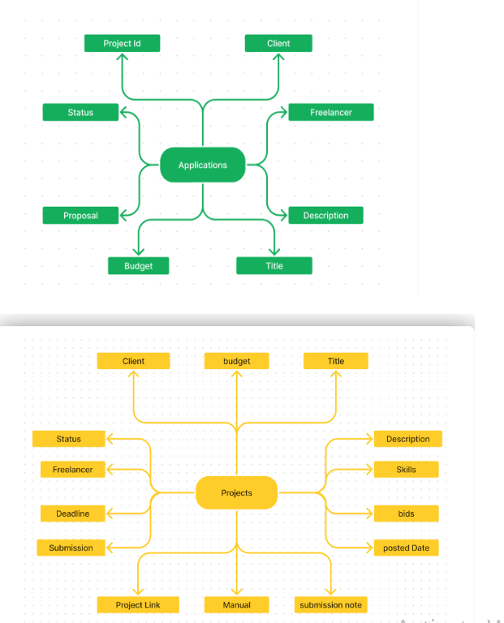
BLOCK DIAGRAM

Slide 10
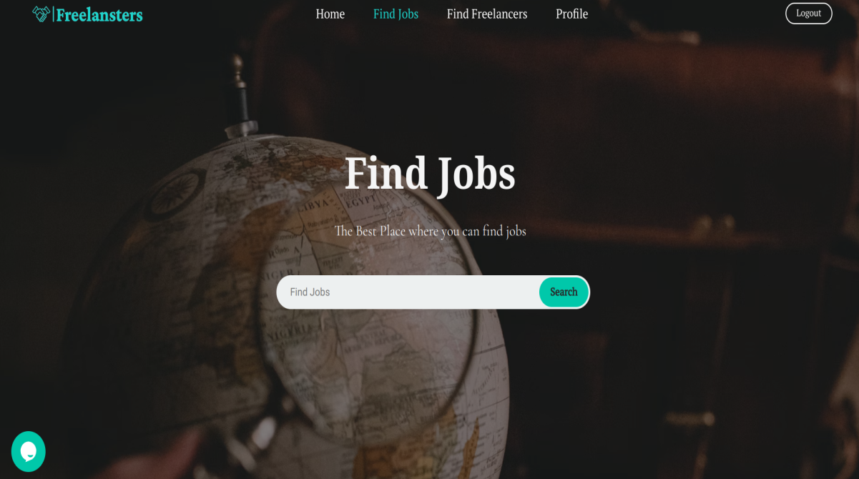
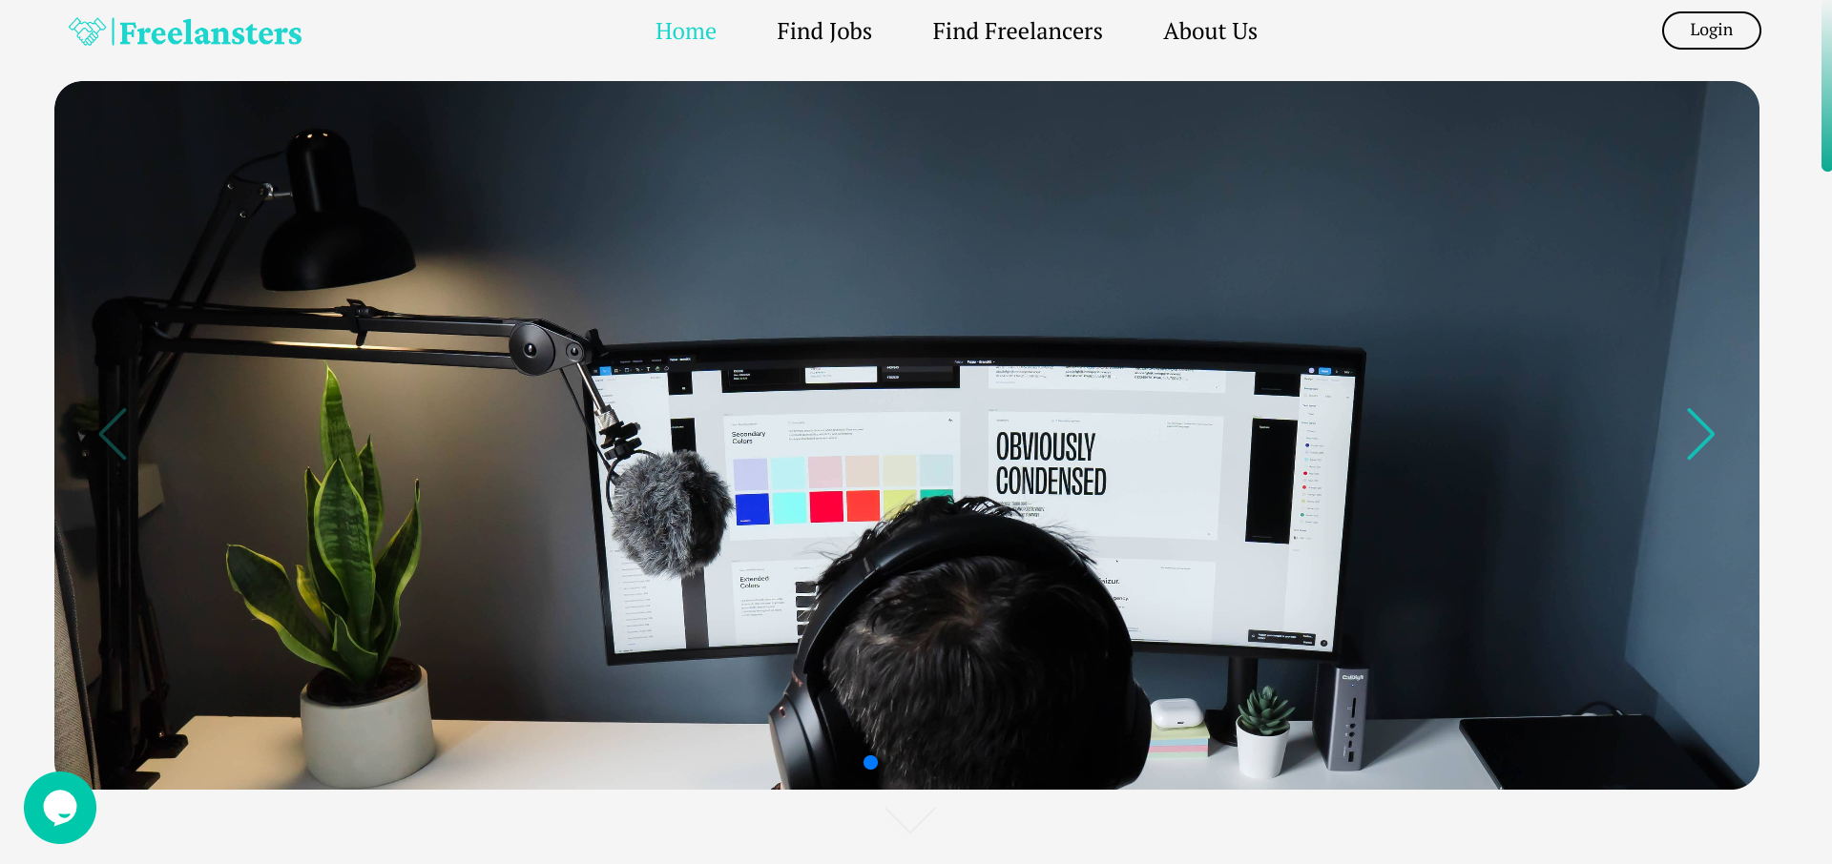
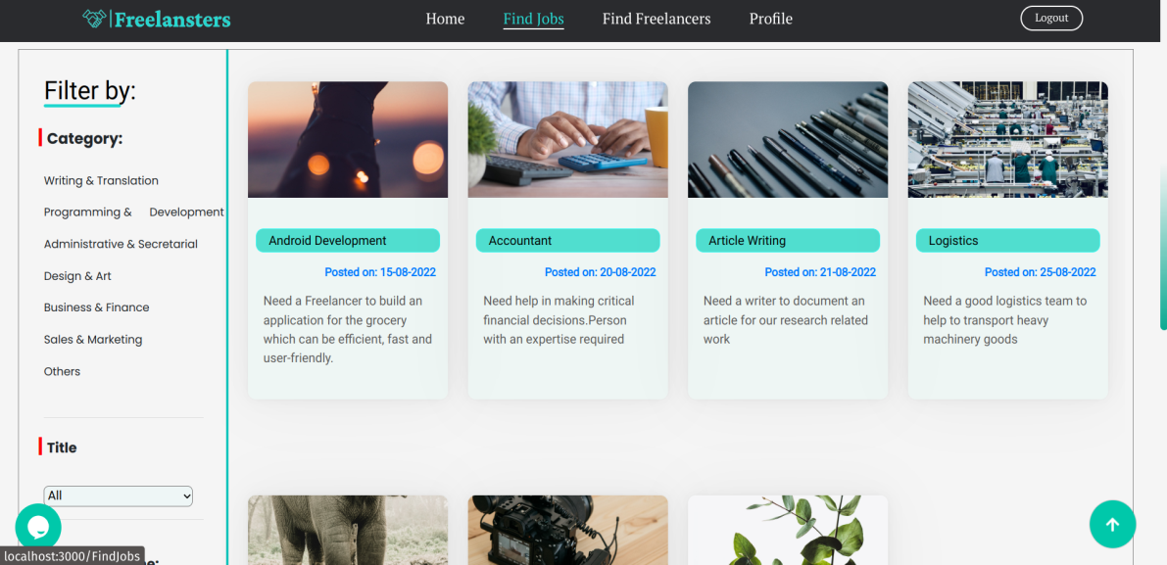
MODEL SCREENSHOT

Slide 11
CONCLUSION
The Freelancing Application offers a comprehensive solution for clients and freelancers to connect and manage projects efficiently. By leveraging the MERN stack, the platform ensures a responsive and user-friendly interface, secure data handling, and streamlined project management processes. This platform not only reduces the administrative burden of hiring freelancers and managing jobs but also enhances user satisfaction through real-time updates and communication. Its scalability makes it suitable for freelancers and businesses of varying sizes and industries.

Slide 12
THANK YOU!

